Slide 1
From Good to Great
Chelsei Carpenter

Slide 2
Location: Albion, MI
Enrollment: 1500
Residential college
Individual campus visits
Tour guides: 100
Overnight hosts: 55
Telecounselors: 12
Admission Associates: 10

Slide 3
#1 Factor in College Decision

Slide 4
Location
Graduation Outcomes
Academic Reputation
Affordability

Slide 5
#1 Factor in College Decision
“Feel” of Campus

Slide 6
Commander’s Intent
“Never tell people how to do things. Tell them what to do and they will surprise you with their ingenuity.”
-General George S. Patton

Slide 7
1. Understanding Campus Life

Slide 8
1. Understanding Campus Life

Slide 9
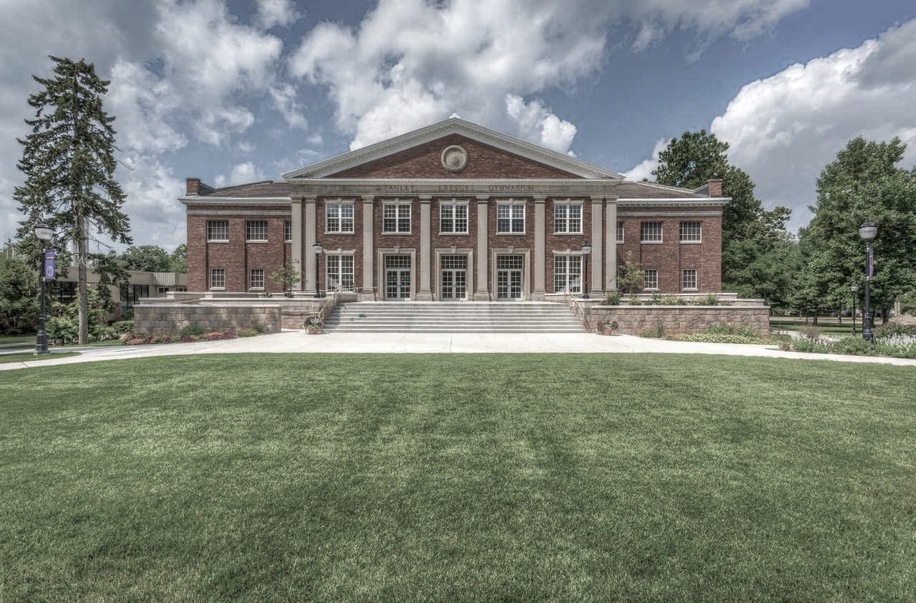
2. Understanding Their Campus Life

Slide 10
3. Making Families Feel Welcome/Valued

Slide 11
Questions?

